Slide 1

Cardiovascular Disease Prediction
Developing and Interpreting a Neural Network Model
Cat Kim BUAN 6382 Applied Deep Learning
The University of Texas at Dallas
May 2, 2025

Slide 2
Problem Statement & Dataset
Problem: Build a model to predict the presence of cardiovascular disease based on patient health examination data
Dataset: Cardio Vascular Disease Detection dataset (Kaggle)
69,301 Records, 12 features
Binary target variable: cardio (0: No Disease, 1: Disease)
Health Metrics & Lifestyle Factors
Table of Health Metrics & Lifestyle Factors
Variable | Type
Age (“age”) | Non-binary (integer)
Gender (“gender”) | Categorical (integer)
Height (“height”) | Non-binary (integer)
Weight (“weight”) | Non-binary (float)
Systolic blood pressure (“ap_hi”) | Non-binary (integer)
Diastolic blood pressure (“ap_low”) | Non-binary (integer)
Cholesterol (“cholesterol”) | Categorical (integer)
Glucose (“gluc”) | Categorical (integer)
Smoking (“smoke”) | Binary
Alcohol Intake (“alco”) | Binary
Physical Activity (“active”) | Binary
https://www.kaggle.com/datasets/bhadaneeraj/cardio-vascular-disease-detection

Slide 3
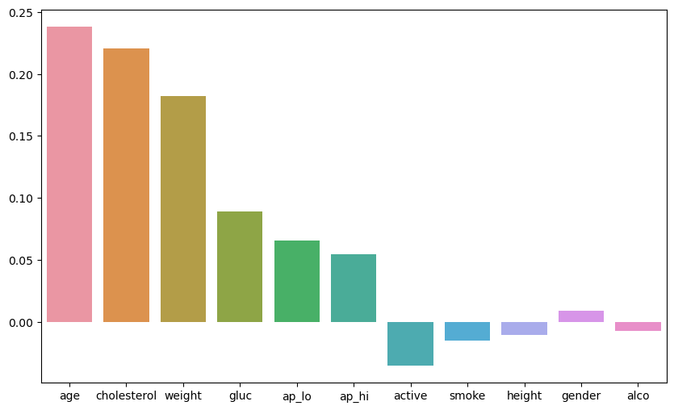
Problem Statement & Dataset
Problem: Build a model to predict the presence of cardiovascular disease based on patient health examination data
Dataset: Cardio Vascular Disease Detection dataset (Kaggle)
69,301 Records, 12 features
Binary target variable: cardio (0: No Disease, 1: Disease)
Health Metrics & Lifestyle Factors
Data Cleaning: Removed 24 duplicates
Target Leakage detection

Slide 4
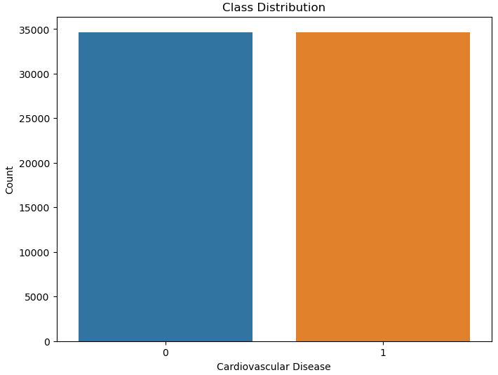
Problem Statement & Dataset
Problem: Build a model to predict the presence of cardiovascular disease based on patient health examination data
Dataset: Cardio Vascular Disease Detection dataset (Kaggle)
69,301 Records, 12 features
Binary target variable: cardio (0: No Disease, 1: Disease)
Health Metrics & Lifestyle Factors
Data Cleaning: Removed 24 duplicates
Class Distribution: Fairly balanced
No cardiovascular disease: 50.06%
Cardiovascular disease: 49.94%

Slide 5
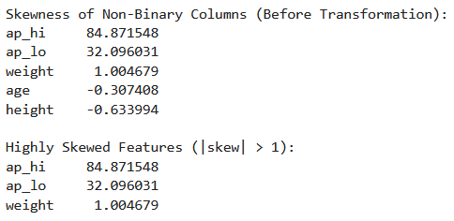
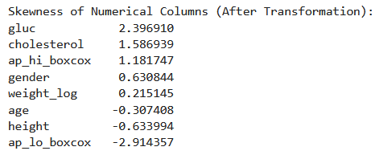
Data Pre-processing
Remove ‘id’ column
Feature Transformation
Box-Cox transformation to “ap_hi” and “ap_lo” to reduce skewness.
Log transformation (np.log1p) to “weight”
Notes:
Applied Box-Cox transformation to ap_hi and ap_lo to reduce skewness.

Slide 6
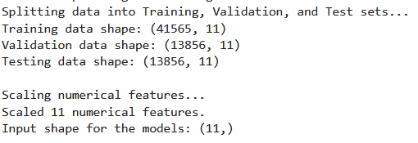
Data Pre-processing
Remove ‘id’ column
Feature Transformation
Box-Cox transformation to “ap_hi” and “ap_lo” to reduce skewness.
Log transformation (np.log1p) to “weight”
Data Splitting Using Stratified Sampling
Training set: 60%
Validation Set: 20%
Test Set: 20%
Feature Scaling
StandardScaler for numerical features on training data
Notes:
Applied Box-Cox transformation to ap_hi and ap_lo to reduce skewness.

Slide 7
Model Architectures & Hyperparameters
1 hidden layer: 16 neurons & ReLU
Dropout rate: 0.1
Optimizer: Adam LR
Epochs: 100
Batch Size: 32
Patience: 10
2 Layers + Adam
2 hidden layer: 64/32 neurons & ReLU
Dropout rate: 0.2
Optimizer: Adam
Epochs: 100
Batch Size: 32
Patience: 10
3 Layers + Adam
3 hidden layers: 128/64/32 neurons & ReLU
Dropout rate: 0.3
Optimizer: Adam
Epochs: 100
Batch Size: 64
Patience: 15
2 Layers + SGD
Dropout rate: 0.2
Optimizer: SGD
Epochs: 100
Batch Size: 32
Patience: 10
2 Layers + Adam Lower Dropout
2 hidden layers: 64/32 neurons & ReLU
Dropout rate: 0.1
Optimizer: Adam
Epochs: 100
Batch Size: 32
Patience: 10
2 hidden layers: 64/32 neurons & ReLU
Learning Rate: 0.001
Learning Rate: 0.001
Learning Rate: 0.005
Learning Rate: 0.01
Learning Rate: 0.001
1 Layer + Adam
Sigmoid in output
Sigmoid in output
Sigmoid in output
Sigmoid in output
Sigmoid in output

Slide 8
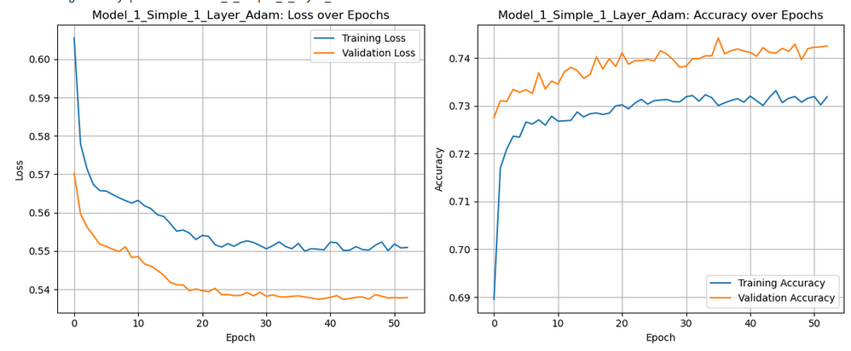
Model Comparison & Training
Objective: Identify the optimal Neural Network architecture and hyperparameters by comparing the performance of multiple configurations.
Note: Each model was independently trained on the Training Data.

Slide 9
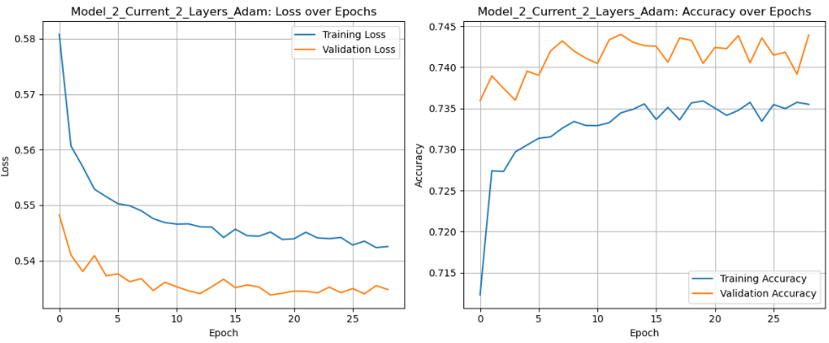
Model Comparison & Training
Objective: Identify the optimal Neural Network architecture and hyperparameters by comparing the performance of multiple configurations.
Note: Each model was independently trained on the Training Data.

Slide 10
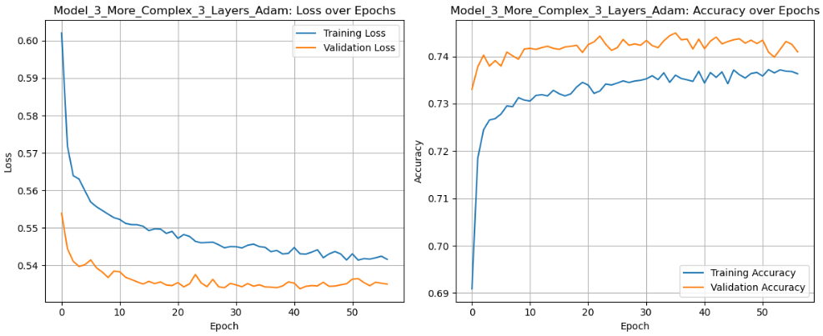
Model Comparison & Training
Objective: Identify the optimal Neural Network architecture and hyperparameters by comparing the performance of multiple configurations.
Note: Each model was independently trained on the Training Data.

Slide 11
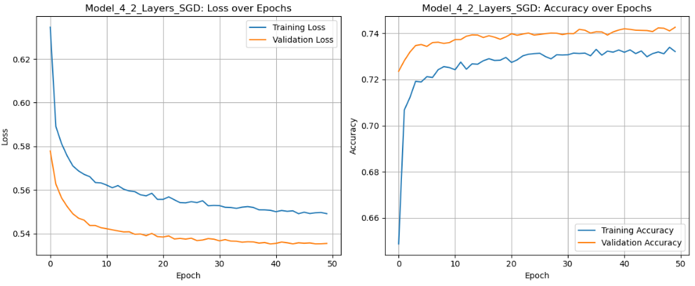
Model Comparison & Training
Objective: Identify the optimal Neural Network architecture and hyperparameters by comparing the performance of multiple configurations.
Note: Each model was independently trained on the Training Data.

Slide 12
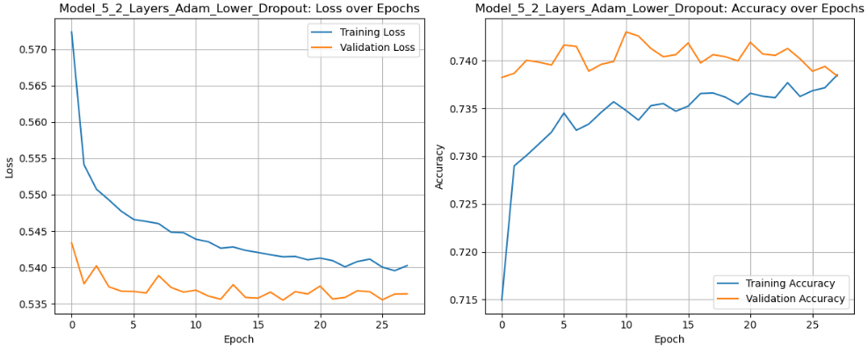
Model Comparison & Training
Objective: Identify the optimal Neural Network architecture and hyperparameters by comparing the performance of multiple configurations.
Note: Each model was independently trained on the Training Data.

Slide 13
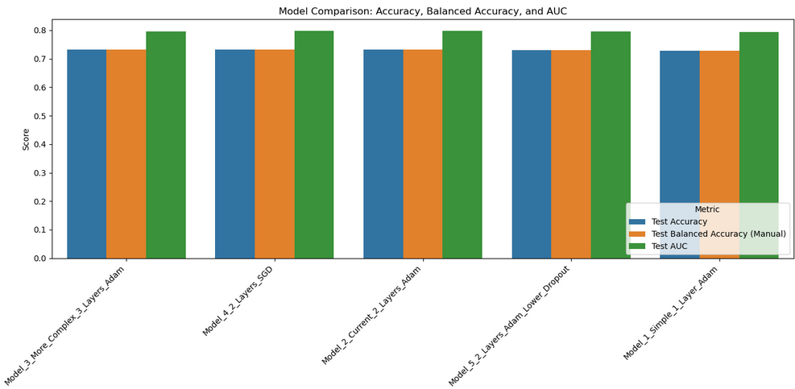
Model Comparison Using Metrics

Slide 14

Model Evaluation Using the Test Dataset
2 LAYERS + ADAM LOWER DROPOUT RATE
2 LAYERS + ADAM
3 LAYERS + ADAM
Runner Up
HIGHEST F1 & RECALL
F1 | 0.724
Balanced Acc. | 0.730
AUC | 0.797
Precision | 0.740
Recall | 0.709
Training Time (s) | 307.1
Epoch(s) | 29
Total Parameters | 2,689
Top Performer
BEST BALANCE
F1 | 0.721
Balanced Acc. | 0.731
AUC | 0.798
Precision | 0.748
Recall | 0.697
Training Time (s) | 274.7
Epoch(s) | 28
Total Parameters | 2,689
Honorable Mention
HIGHEST PRECISION
F1 | 0.716
Balanced Acc. | 0.729
AUC | 0.7967
Precision | 0.752
Recall | 0.683
Training Time (s) | 380.6
Epoch(s) | 57
Total Parameters | 11,521

Slide 15
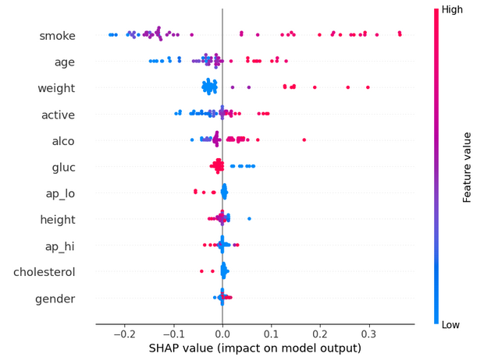
SHAP: Global Feature Importance & Impact
Smoking, age, and weight have the largest impact on predictions.
High smoke and age values push predictions toward cardiovascular risk.
cholesterol and Systolic blood pressure (“ap_hi”), while clinically important, had lower global SHAP values — suggesting lower variability or reduced sensitivity in the model to these inputs.

Slide 16
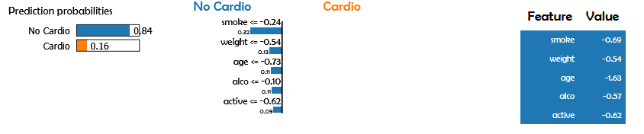
LIME: Local Explanation for One Prediction
Top 5 Predictive Factors
The model predicted No Cardio (0.84 probability) for this individual.
All features pushed the prediction toward "No Cardio“
Aligning with clinical logic:
Lower risk behaviors → Lower cardiovascular risk

Slide 17
Challenges Faced & Overcoming Them
Precision–Recall Trade-off & Model Strategy
False negatives are more dangerous than false positives.
Used F1, AUC, PR curves to evaluate beyond accuracy.
Tuned thresholds to prioritize clinical relevance.
Future Considerations
Recall ↑ or Precision ↓
Trade-off matters in medical risk.
Use ensemble methods to boost performance.
Tried multiple models for balance & interpretability.
Different hyperparameters
Computational time

Slide 18
Summary
The 2 Layer + Adam with Lower Dropout has strongest balance of performance, efficiency, and interpretability,
Ideal candidate for real-world health risk prediction deployment.
Top Performer
BEST BALANCE
F1 | 0.721
Balanced Acc. | 0.731
AUC | 0.798
Precision | 0.748
Recall | 0.697
Training Time (s) | 274.7
Epoch(s) | 28
Total Parameters | 2,689
2 Layers + Adam Lower Dropout
2 hidden layers: 64/32 neurons & ReLU
Dropout rate: 0.1
Best F1 + Precision combo without sacrificing Recall
Optimizer: Adam
Learning Rate: 0.001
Epochs: 100
Batch Size: 32
Patience: 10
Sigmoid in output
Early convergence & lightweight

Slide 19
Thank You!

